Slide 1
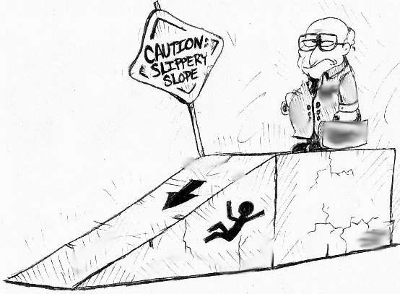
Static and Kinetic Friction
Nerik Yakubov Robert Magee David Chen

Slide 2
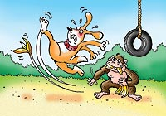
Instructional Objectives
Distinguish the Difference Between Static & Kinetic Friction
Solve Problems Involving Friction Effects

Slide 3
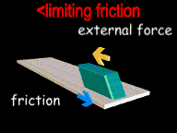
What is Friction?
Force that acts oppose the relative motion of two surfaces
High for dry and rough surfaces
Low for smooth and wet surfaces

Slide 4

Free Body Diagram
Normal Force F_{N}
Applied Force F
Friction Force f_{f}
Gravity Force F_{g}
F_{g} = mg
F_{N} = F_{g}
f_{f} = F

Slide 5
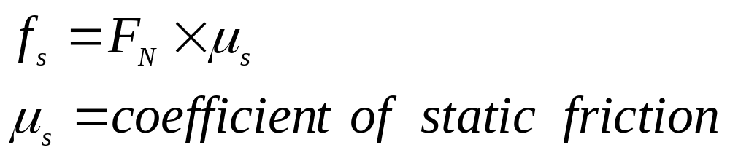
Static Friction
The Force of Static Friction keeps a stationary object at rest!
F_{N}
F
f_{s}
F_{g}

Slide 6
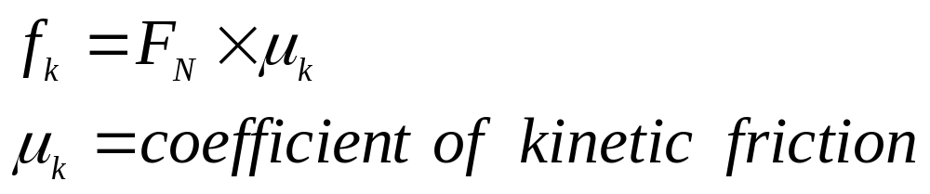
Kinetic Friction
Once the Force of Static Friction is overcome, the Force of Kinetic Friction is what slows down a moving object!
Motion
F_{N}
F
f_{k}
F_{g}

Slide 7
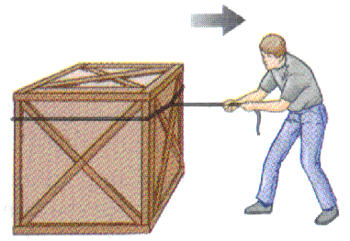
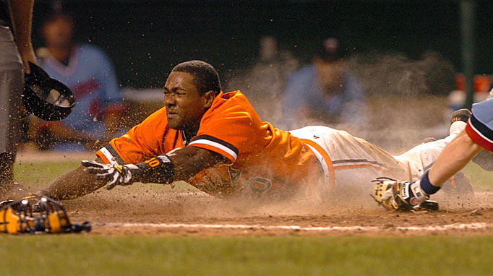
Types of Friction
To initiate motion of the box the man must overcome the Force of Static Friction
Upon sliding, the baseball player will come to a complete stop due to the Force of Kinetic Friction
I better be safe Ump!!

Slide 8
Static & Kinetic Friction Coefficients
Material | Coefficient of Static Friction μ_{S} | Coefficient of Kinetic Friction μ_{S}
Rubber on Glass | 2.0+ | 2.0
Rubber on Concrete | 1.0 | 0.8
Steel on Steel | 0.74 | 0.57
Wood on Wood | 0.25 – 0.5 | 0.2
Metal on Metal | 0.15 | 0.06
Ice on Ice | 0.1 | 0.03
Synovial Joints in Humans | 0.01 | 0.003

Slide 9
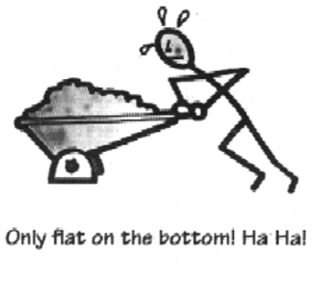
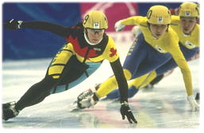
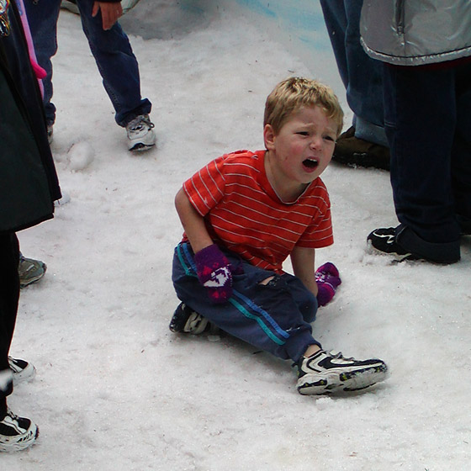
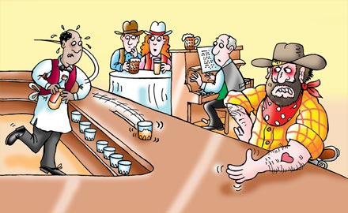
Static VS. Kinetic Friction

Slide 10

Static Friction Lab Procedure
Connect the force detector to a block of wood
Pull gently on the force sensor unit the block begins to move
Move the block slowly with constant force

Slide 11
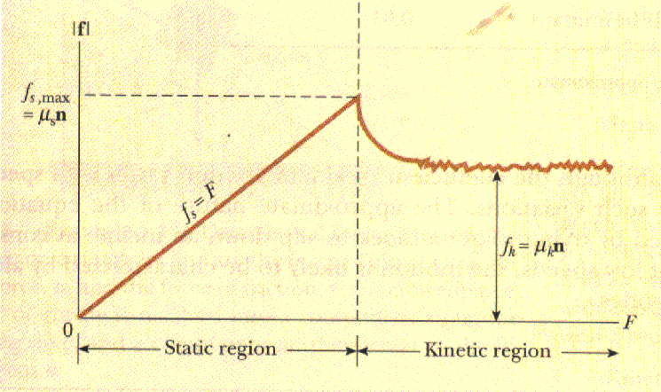
Ideal Result

Slide 12
Kinetic Friction Lab Procedure
Line up the block with the motion detector
Push the block gently toward the motion detector so that it comes to a stop approximately 1 foot away from it
From the velocity curve determine the deceleration of the block
Calculate the Force of Kinetic Friction
Determine the coefficient of Kinetic Friction
Wooden block
Push

Slide 13



Application Analysis
An empty cart is being rolled across a warehouse floor. If the cart was filled, the force of kinetic friction between the cart and the floor would
  Decrease
  Increase
  Remain the same

Slide 14

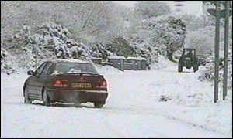
Application Analysis
Sand is often placed on an icy road because the sand:
  Decreases the coefficient of friction between the tires of a car and the road
  Increases the coefficient of friction between the tires of a car and the road
  Decrease the gravitational force on a car
  Increases the normal force of a car on the road

Slide 15

Questions?

